Slide 1
SINGLE LINKED LIST
Single Linked Lists in C

Slide 2
TABLE OF CONTENTS
01
03
02
04
01
Introduction to Singly Linked Lists
Create, Traverse, Insertion, Deletion of Singly Linked List
Structure of a Singly Linked List Node
Advantages and Disadvantages

Slide 3

INTRODUCTION
Linked List
A linked list is a linear data structure that includes a series of connected nodes. Here, each node stores the data and the address of the next node.

Slide 4
INTRODUCTION
Types of Linked List
Singly Linked List
Doubly Linked List
Circular Linked List

Slide 5
01
Singly Linked List

Slide 6
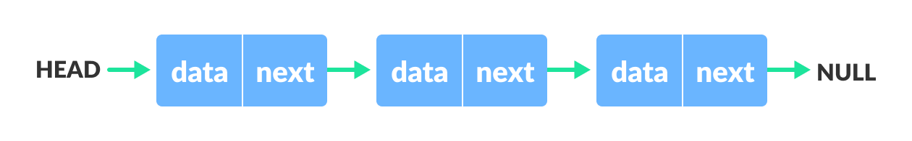
ABOUT SINGLY LINKED LIST
A single linked list is a data structure that consists of nodes, where each node contains data and a reference (or link) to the next node in the sequence.

Slide 7
02
Structure of a Singly Linked List

Slide 8
Structure of Singly Linked List
Step 1
Step 2
Step 3
Step 4
Step 5
Step 6
Definition of Node
Head Pointer
Memory Allocation
Assign the Data
Connect the node with Each other
Print the data.

Slide 9
Data :- Stores the value. Pointer(next):- Stores the address of the next node.
struct Node {
int data;
struct Node* next;
};

Slide 10
03
1. Creation of Singly.

Slide 11
DEFINITION OF CONCEPTS
Steps:
DEFINITION OF CONCEPTS
struct Node{
int data;
struct Node* next;
};
int main(){
struct Node* head = NULL;
struct Node* second = NULL;
struct Node* third = NULL;
head =(struct Node*)malloc(sizeof(struct Node));
second =(struct Node*)malloc(sizeof(struct Node));
third = (struct Node*)malloc(sizeof(struct Node));
head->data = 1;
second->data = 2;
third->data = 3;
head->next = second;
second->next = third;
third->next = NULL;
Initialize the head pointer to NULL.
Allocate memory for new nodes.
Link nodes together.

Slide 12
03
2. Traversing of Singly.

Slide 13
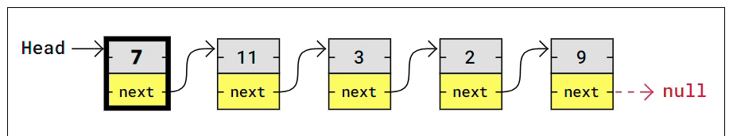
Traversing means visiting each node in the list starting from the head node and proceeding till the last node.

Slide 14
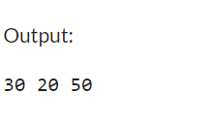
$96,290
-4.30 %
5,500,000
#include <stdio.h>
#include <stdlib.h>
struct node {
struct node *next;
int data;
};
int main() {
struct node *one = NULL;
struct node *two = NULL;
struct node *three = NULL;
struct node *head = NULL; // Initialize head to NULL
// Memory allocation
one = malloc(sizeof(struct node));
two = malloc(sizeof(struct node));
three = malloc(sizeof(struct node));
// Assign the value
one->data = 30;
two->data = 20;
three->data = 50;
// Connecting
one->next = two;
two->next = three;
three->next = NULL;
head = one; // Set head to one
while (head!= NULL) {
printf("%d ", head->data);
head = head->next;
}
// free the allocated memory
free(one);
free(two);
free(three);
return 0;
}
ASP.NET usage is decreasing
active PHP developers

Slide 15
03
3. Insertion of Singly

Slide 16
Types of Insertion of Singly LL
At the End
At the Begining
After a given Node
At the End
At the Begining
Venus is the second planet from the Sun
Saturn is a gas giant and has several rings

Slide 17
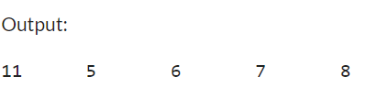
20.4
struct node {
struct node *next;
int data;
};
int main() {
struct node *head;
struct node *second;
struct node *third;
struct node *fourth;
struct node *fifth;
//Memory Allocation
second=malloc(sizeof(struct node));
third=malloc(sizeof(struct node));
fourth=malloc(sizeof(struct node));
fifth=malloc(sizeof(struct node));
//Assign the Value
head=second;
second->data=5;
third->data=6;
fourth->data=7;
fifth->data=8;
// connecting the node
second->next=third;
third->next=fourth;
fourth->next=fifth;
fifth->next=NULL;
//At the Begining
struct node *ptr=(struct node*)malloc(sizeof(struct node));
ptr->data=11;
ptr->next=head;
head=ptr;
//Printing
while(head!=NULL){
printf("%d\t", head->data);
head=head->next;
}
}
Code Snippt
million active developers use JavaScript over
other programming languages

Slide 18
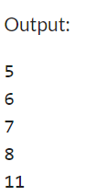

End and At given Node
 | Mass | Diameter | Gravity
Android | 1.25 | 0.50 | 13.2
HTML5 | 3.20 | 2.75 | 20.5
Python | 50.5 | 10.5 | 12.4
//At the End
struct node *ptr =(struct node*)malloc(sizeof(struct node));
ptr->data = 11;
fifth->next = ptr;
ptr->next = NULL;
while(head!=NULL){
printf("%d\n",head->data);
head=head->next;
}
//At a given node
struct node *ptr =(struct node*)malloc(sizeof(struct node));
ptr->data = 11;
third->next=ptr;
ptr->next=fourth;
while(head!=NULL){
printf("%d\n",head->data);
head=head->next;
}

Slide 19
03
3.Deletion of Singly

Slide 20
Types of Deletion of Singly LL
From the End
From the Begining
From a given Node
Venus is the second planet from the Sun
Saturn is a gas giant and has several rings

Slide 21

Code Snipit
85%
40%
head=one;
one->data=11;
two->data=34;
three->data=44;
Four->data=55;
one->next=two;
two->next=three;
three->next=four;
four->next=NULL;
while(head!=NULL){
printf("%d\n",head->data);
head=head->next;
}
}
#include<stdio.h>
#include<stdlib.h>
struct node {
struct node *next;
int data; };
int main(){
struct node *head;
struct node *one;
struct node *two;
struct node *three;
struct node *four; one=malloc(sizeof(struct node));
two=malloc(sizeof(struct node));
three=malloc(sizeof(struct node));
four=malloc(sizeof(struct node));
Venus has a beautiful name
Mercury is the smallest planet

Slide 22
At Begining
struct node *ptr;
ptr = head;
head = ptr->next;
free(ptr);
while(head!=NULL){
printf("%d\n",head->data);
head=head->next;
}
You can replace the image on the screen with your own work. Just move the filter aside, delete this picture, add yours and place the filter on top again
Output :
34
44
55

Slide 23
At End
//at end void addAtEnd(struct node *head, int data) {
struct node *new_node = malloc(sizeof(struct node)); new_node->data = data;
new_node->next = NULL;
struct node *temp = head;
while (temp->next != NULL) {
temp = temp->next; }
temp->next = new_node; }
You can replace the image on the screen with your own work. Just move the filter aside, delete this picture, add yours and place the filter on top again
Output :
11
34
44

Slide 24
Delete a given node
//delete a given node.
for(int i =2;i<position;i++)
If(ptr->next!=NULL){
ptr=ptr->next;
}
}
ptr->next = ptr->next->next;
You can replace the image on the screen with your own work. Just move the filter aside, delete this picture, add yours and place the filter on top again
Output :
11
44
55

Slide 25

ADVANTAGES AND DISADVANTAGES

Slide 26
Singly Linked List
Dynamic Size
Efficient insertions/deletions.
Advantages
Can grow or shrink in size as needed.
Easy to implement.
Saturn is composed of hydrogen and helium

Slide 27
Disadvantages
More memory usage due to pointers.
More complex to reverse a linked list compared to an array.
Head
Data |Next
Data |Next
Data |Next
Data |Next
NULL
No random access.
Potentially higher latency for access due to traversal.

Slide 28

Conclusion
Summary: Recap of key points:Definition and structure.
Creation, traversal, insertion, and deletion.
Advantages and disadvantages.
___

Slide 29


PRESENTED BY
SUMANT KUMAR

Slide 30



THANKS YOU
Sumant Kumar
Btech Student
8235134811
@ambivert_sumant
Please, keep this slide for attribution.

